Slide 1
HTK Tutorial
by Ming-Yi Tsai
pancho@speech.ee.ntu.edu.tw

Slide 2
Outline
Introduction to HTK
  What is HTK
  History of HTK
  Getting HTK
  HTK Toolkit
HTK in depth
Exercise

Slide 3
What is HTK
Hidden Markov Model Toolkit
  a portable toolkit
  available in C source form
  primarily used for speech recognition research
Notes:
a portable toolkit for building and manipulating hidden Markov models
HTK consists of a set of library modules and tools available in C source form
HTK is primarily used for speech recognition research although it has been used for numerous other applications including research into speech synthesis, character recognition and DNA sequencing

Slide 4
What is HTK
Hidden Markov Model Toolkit
  provide sophisticated facilities
    speech analysis
    HMM training
    Testing
    results analysis
Notes:
The tools provide sophisticated facilities for speech analysis, HMM training, testing and results analysis.

Slide 5
History of HTK
originally developed at the Speech Vision and Robotics Group of the Cambridge University Engineering Department (CUED)
In 1993 Entropic Research Laboratory Inc. acquired the rights to sell HTK
HTK was sold by Entropic until 1999 when Microsoft bought Entropic
Notes:
HTK was originally developed at the Speech Vision and Robotics Group of the Cambridge University Engineering Department (CUED) where it has been used to build CUED's large vocabulary speech recognition systems (see CUED HTK LVR). In 1993 Entropic Research Laboratory Inc. acquired the rights to sell HTK and the development of HTK was fully transferred to Entropic in 1995 when the Entropic Cambridge Research Laboratory Ltd was established. HTK was sold by Entropic until 1999 when Microsoft bought Entropic. Microsoft has now licensed HTK back to CUED and is providing support so that CUED can redistribute HTK and provide development support via the HTK3 web site. See History of HTK for more details.

Slide 6
Getting HTK
Currently the only release version of HTK is version 3.0 (HTK3)
http://htk.eng.cam.ac.uk
  source code
  Documentation
  Mailing Lists
  …

Slide 7
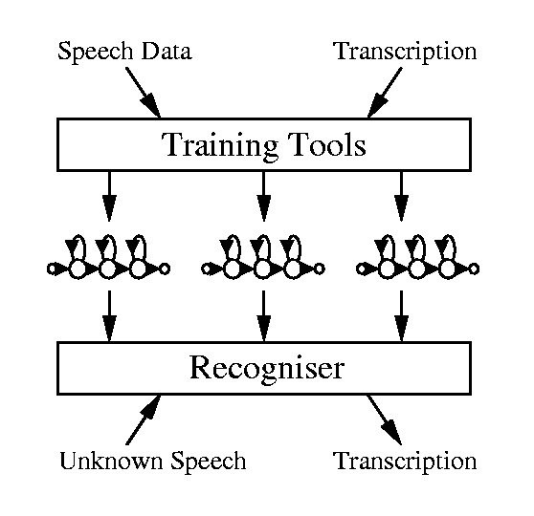
The Fundamentals of HTK
Notes:
Firstly, the HTK training tools are used to estimate the parameters of a set of HMMs using training utterances and their associated transcriptions. Secondly, unknown utterances are transcribed using the HTK recognition tools.

Slide 8
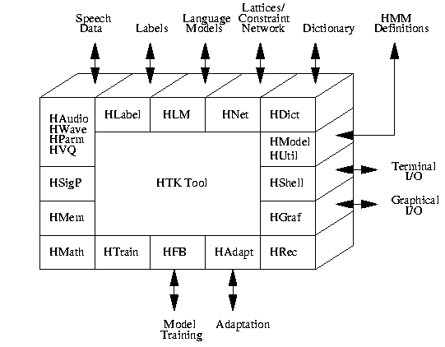
An Overview of the HTK Toolkit
Notes:
Much of the functionality of HTK is built into the library modules
User input/output and interaction with the operating system is controlled by the library module HSHELL and all memory management is controlled by HMEM. Math support is provided by HMATH and the signal processing operations needed for speech analysis are in HSIGP. Each of the file types required by HTK has a dedicated interface module. HLABEL provides the interface for label files, HLM for language model files, HNET for networks and lattices, HDICT for dictionaries, HVQ for VQ codebooks and HMODEL for HMM definitions.
All speech input and output at the waveform level is via HWAVE and at the parameterised level via HPARM. As well as providing a consistent interface, HWAVE and HLABEL support multiple file formats allowing data to be imported from other systems. Direct audio input is supported by HAUDIO and simple interactive graphics is provided by HGRAF. HUTIL provides a number of utility routines for manipulating HMMs while HTRAIN and HFB contain support for the various HTK training tools. HADAPT provides support for the various HTK adaptation tools. Finally, HREC contains the main recognition processing functions.

Slide 9
Generic Properties of a HTK Tool
command-line style interface
  HFoo -T 1 -C config -f 34.3 -a -s myfile file1 file2
Notes:
This tool has two main arguments called file1 and file2 plus four optional arguments
the operation of a tool can be controlled by parameters stored in a configuration file

Slide 10
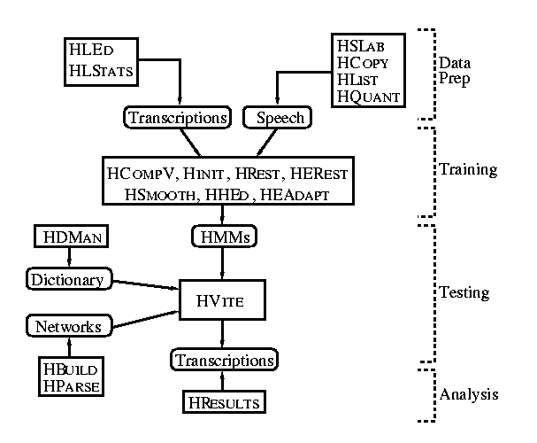
The Toolkit
Notes:
HCOPY is used to copy one or more source files to an output file
HLIST can be used to check the contents of any speech file
HLED is a script-driven label editor which is designed to make the required transformations to label files
HLSTATS can gather and display statistics on label files and where required
HQUANT can be used to build a VQ codebook in preparation for building discrete probability HMM system.

Slide 11
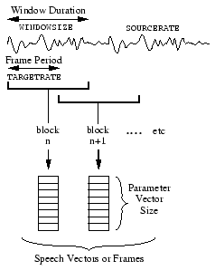
Copying the data
Notes:
HCOPY is used to copy one or more source files to an output file
HLIST can be used to check the contents of any speech file
HLED is a script-driven label editor which is designed to make the required transformations to label files
HLSTATS can gather and display statistics on label files and where required
HQUANT can be used to build a VQ codebook in preparation for building discrete probability HMM system.

Slide 12
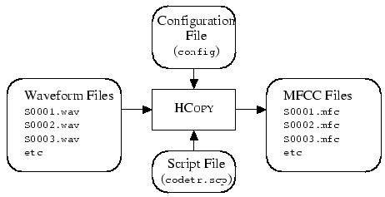
Copying the data
Notes:
HCOPY is used to copy one or more source files to an output file
HLIST can be used to check the contents of any speech file
HLED is a script-driven label editor which is designed to make the required transformations to label files
HLSTATS can gather and display statistics on label files and where required
HQUANT can be used to build a VQ codebook in preparation for building discrete probability HMM system.

Slide 13
The Toolkit
Notes:
HCOPY is used to copy one or more source files to an output file
HLIST can be used to check the contents of any speech file
HLED is a script-driven label editor which is designed to make the required transformations to label files
HLSTATS can gather and display statistics on label files and where required
HQUANT can be used to build a VQ codebook in preparation for building discrete probability HMM system.

Slide 14
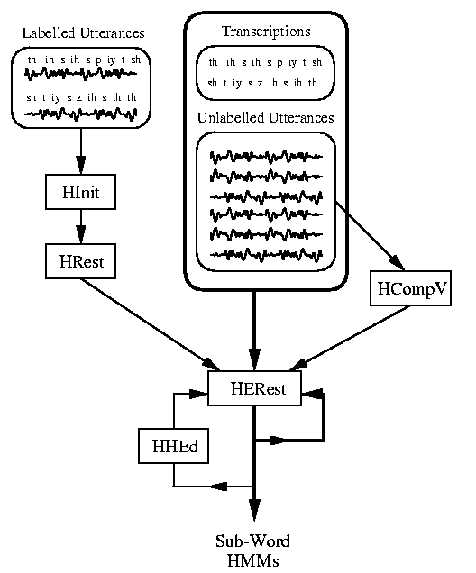
Training Sub-Word HMMs
Notes:
If there is some speech data available for which the location of the sub-word (i.e. phone) boundaries have been marked, then this can be used as bootstrap data
HINIT and HREST provide isolated word style training using the fully labelled bootstrap data
HINIT reads in all of the bootstrap training data and cuts out all of the examples of the required phone. It then iteratively computes an initial set of parameter values using a segmental k-means procedure. On the first cycle, the training data is uniformly segmented, each model state is matched with the corresponding data segments and then means and variances are estimated
On the second and successive cycles, the uniform segmentation is replaced by Viterbi alignment
the fully labelled bootstrap data is used but this time the segmental k-means procedure is replaced by the Baum-Welch re-estimation procedure
so-called flat start can be used. In this case all of the phone models are initialised to be identical and have state means and variances equal to the global speech mean and variance
HEREST performs a single Baum-Welch re-estimation of the whole set of HMM phone models simultaneously

Slide 15
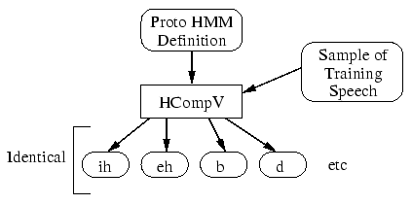
Flat-start Initialization

Slide 16
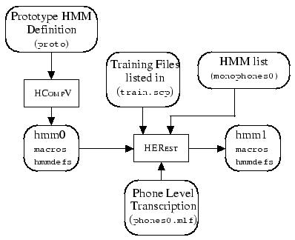
Flat-start initialization and training

Slide 17
Training Sub-Word HMMs
Notes:
If there is some speech data available for which the location of the sub-word (i.e. phone) boundaries have been marked, then this can be used as bootstrap data
HINIT and HREST provide isolated word style training using the fully labelled bootstrap data
HINIT reads in all of the bootstrap training data and cuts out all of the examples of the required phone. It then iteratively computes an initial set of parameter values using a segmental k-means procedure. On the first cycle, the training data is uniformly segmented, each model state is matched with the corresponding data segments and then means and variances are estimated
On the second and successive cycles, the uniform segmentation is replaced by Viterbi alignment
the fully labelled bootstrap data is used but this time the segmental k-means procedure is replaced by the Baum-Welch re-estimation procedure
so-called flat start can be used. In this case all of the phone models are initialised to be identical and have state means and variances equal to the global speech mean and variance
HEREST performs a single Baum-Welch re-estimation of the whole set of HMM phone models simultaneously

Slide 18
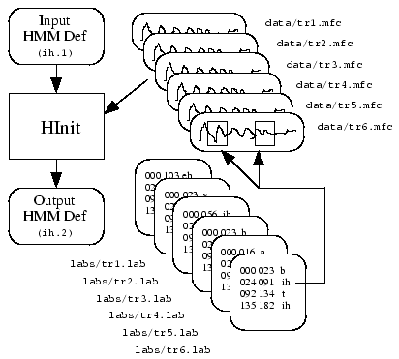
HInit with Bootstrap data
Notes:
If there is some speech data available for which the location of the sub-word (i.e. phone) boundaries have been marked, then this can be used as bootstrap data
HINIT and HREST provide isolated word style training using the fully labelled bootstrap data
HINIT reads in all of the bootstrap training data and cuts out all of the examples of the required phone. It then iteratively computes an initial set of parameter values using a segmental k-means procedure. On the first cycle, the training data is uniformly segmented, each model state is matched with the corresponding data segments and then means and variances are estimated
On the second and successive cycles, the uniform segmentation is replaced by Viterbi alignment
the fully labelled bootstrap data is used but this time the segmental k-means procedure is replaced by the Baum-Welch re-estimation procedure

Slide 19
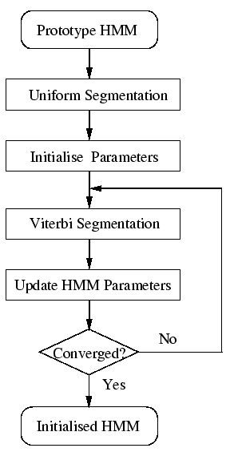
HInit with Bootstrap data
Notes:
If there is some speech data available for which the location of the sub-word (i.e. phone) boundaries have been marked, then this can be used as bootstrap data
HINIT and HREST provide isolated word style training using the fully labelled bootstrap data
HINIT reads in all of the bootstrap training data and cuts out all of the examples of the required phone. It then iteratively computes an initial set of parameter values using a segmental k-means procedure. On the first cycle, the training data is uniformly segmented, each model state is matched with the corresponding data segments and then means and variances are estimated
On the second and successive cycles, the uniform segmentation is replaced by Viterbi alignment
the fully labelled bootstrap data is used but this time the segmental k-means procedure is replaced by the Baum-Welch re-estimation procedure

Slide 20
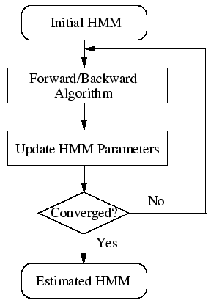
HRest with Bootstrap data
Notes:
If there is some speech data available for which the location of the sub-word (i.e. phone) boundaries have been marked, then this can be used as bootstrap data
HINIT and HREST provide isolated word style training using the fully labelled bootstrap data
HINIT reads in all of the bootstrap training data and cuts out all of the examples of the required phone. It then iteratively computes an initial set of parameter values using a segmental k-means procedure. On the first cycle, the training data is uniformly segmented, each model state is matched with the corresponding data segments and then means and variances are estimated
On the second and successive cycles, the uniform segmentation is replaced by Viterbi alignment
the fully labelled bootstrap data is used but this time the segmental k-means procedure is replaced by the Baum-Welch re-estimation procedure

Slide 21
Training Sub-Word HMMs
Notes:
If there is some speech data available for which the location of the sub-word (i.e. phone) boundaries have been marked, then this can be used as bootstrap data
HINIT and HREST provide isolated word style training using the fully labelled bootstrap data
HINIT reads in all of the bootstrap training data and cuts out all of the examples of the required phone. It then iteratively computes an initial set of parameter values using a segmental k-means procedure. On the first cycle, the training data is uniformly segmented, each model state is matched with the corresponding data segments and then means and variances are estimated
On the second and successive cycles, the uniform segmentation is replaced by Viterbi alignment
the fully labelled bootstrap data is used but this time the segmental k-means procedure is replaced by the Baum-Welch re-estimation procedure
so-called flat start can be used. In this case all of the phone models are initialised to be identical and have state means and variances equal to the global speech mean and variance
HEREST performs a single Baum-Welch re-estimation of the whole set of HMM phone models simultaneously

Slide 22
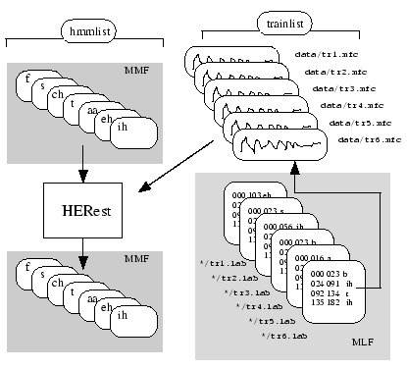
Embedded training
Notes:
If there is some speech data available for which the location of the sub-word (i.e. phone) boundaries have been marked, then this can be used as bootstrap data
HINIT and HREST provide isolated word style training using the fully labelled bootstrap data
HINIT reads in all of the bootstrap training data and cuts out all of the examples of the required phone. It then iteratively computes an initial set of parameter values using a segmental k-means procedure. On the first cycle, the training data is uniformly segmented, each model state is matched with the corresponding data segments and then means and variances are estimated
On the second and successive cycles, the uniform segmentation is replaced by Viterbi alignment
the fully labelled bootstrap data is used but this time the segmental k-means procedure is replaced by the Baum-Welch re-estimation procedure
so-called flat start can be used. In this case all of the phone models are initialised to be identical and have state means and variances equal to the global speech mean and variance
HEREST performs a single Baum-Welch re-estimation of the whole set of HMM phone models simultaneously

Slide 23
Training Sub-Word HMMs
Notes:
If there is some speech data available for which the location of the sub-word (i.e. phone) boundaries have been marked, then this can be used as bootstrap data
HINIT and HREST provide isolated word style training using the fully labelled bootstrap data
HINIT reads in all of the bootstrap training data and cuts out all of the examples of the required phone. It then iteratively computes an initial set of parameter values using a segmental k-means procedure. On the first cycle, the training data is uniformly segmented, each model state is matched with the corresponding data segments and then means and variances are estimated
On the second and successive cycles, the uniform segmentation is replaced by Viterbi alignment
the fully labelled bootstrap data is used but this time the segmental k-means procedure is replaced by the Baum-Welch re-estimation procedure
so-called flat start can be used. In this case all of the phone models are initialised to be identical and have state means and variances equal to the global speech mean and variance
HEREST performs a single Baum-Welch re-estimation of the whole set of HMM phone models simultaneously

Slide 24
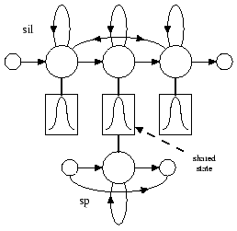
The Silence Model
Notes:
HRESULTS which uses dynamic programming to align the two transcriptions and then count substitution, deletion and insertion errors
HRESULTS can also provide speaker-by-speaker breakdowns, confusion matrices and time-aligned transcriptions

Slide 25
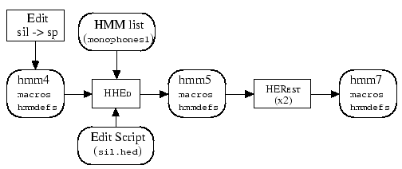
Using HHEd
Notes:
HRESULTS which uses dynamic programming to align the two transcriptions and then count substitution, deletion and insertion errors
HRESULTS can also provide speaker-by-speaker breakdowns, confusion matrices and time-aligned transcriptions

Slide 26
The Toolkit
Notes:
HCOPY is used to copy one or more source files to an output file
HLIST can be used to check the contents of any speech file
HLED is a script-driven label editor which is designed to make the required transformations to label files
HLSTATS can gather and display statistics on label files and where required
HQUANT can be used to build a VQ codebook in preparation for building discrete probability HMM system.

Slide 27
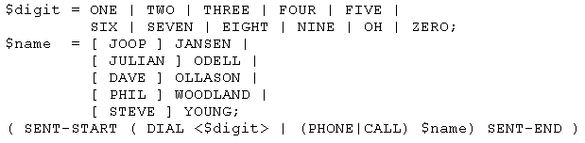
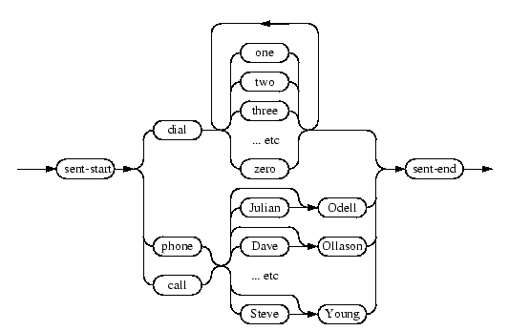
Grammar for voice dialing
Notes:
HRESULTS which uses dynamic programming to align the two transcriptions and then count substitution, deletion and insertion errors
HRESULTS can also provide speaker-by-speaker breakdowns, confusion matrices and time-aligned transcriptions

Slide 28
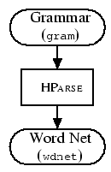
Grammar for voice dialing
Notes:
HRESULTS which uses dynamic programming to align the two transcriptions and then count substitution, deletion and insertion errors
HRESULTS can also provide speaker-by-speaker breakdowns, confusion matrices and time-aligned transcriptions

Slide 29
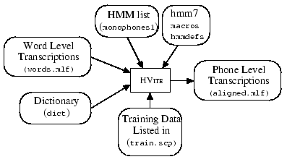
Recognition
Notes:
HRESULTS which uses dynamic programming to align the two transcriptions and then count substitution, deletion and insertion errors
HRESULTS can also provide speaker-by-speaker breakdowns, confusion matrices and time-aligned transcriptions

Slide 30
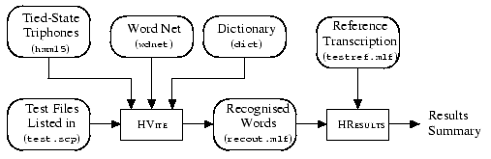
Recognition
Notes:
HRESULTS which uses dynamic programming to align the two transcriptions and then count substitution, deletion and insertion errors
HRESULTS can also provide speaker-by-speaker breakdowns, confusion matrices and time-aligned transcriptions

Slide 31
HTK in Depth
  The Operating Environment
    Speech Input/Output
    Transcriptions and Label Files
    HMM Definition Files
    HMM Parameter Estimation
    HMM Adaptation
    HMM System Refinement
    Discrete and Tied-Mixture Models
    Networks, Dictionaries and Language Models
    Decoding
Notes:
HRESULTS which uses dynamic programming to align the two transcriptions and then count substitution, deletion and insertion errors
HRESULTS can also provide speaker-by-speaker breakdowns, confusion matrices and time-aligned transcriptions
For word spotting applications, it can also compute Figure of Merit (FOM) scores and Receiver Operating Curve (ROC) information

Slide 32
Reference Section
    The HTK Tools
    Configuration Variables
    Error and Warning Codes
    HTK Standard Lattice Format (SLF)
Notes:
HRESULTS which uses dynamic programming to align the two transcriptions and then count substitution, deletion and insertion errors
HRESULTS can also provide speaker-by-speaker breakdowns, confusion matrices and time-aligned transcriptions
For word spotting applications, it can also compute Figure of Merit (FOM) scores and Receiver Operating Curve (ROC) information

Slide 33
Exercise
telnet r531e.ee.ntu.edu.tw
ls /workspace/HTK_Tutorial
  config/
  scp/
  label/
  dic/
  list/
  gram/
  model/
  command/
Notes:
HRESULTS which uses dynamic programming to align the two transcriptions and then count substitution, deletion and insertion errors
HRESULTS can also provide speaker-by-speaker breakdowns, confusion matrices and time-aligned transcriptions
For word spotting applications, it can also compute Figure of Merit (FOM) scores and Receiver Operating Curve (ROC) information

Slide 34
Exercise
Data Preparation
  Coding the data
  Transcription files
  Grammar
  Dictionary
Creating Initial-Final HMM
  training data
Recognizer evaluation
  Recognizing the test data
Notes:
HRESULTS which uses dynamic programming to align the two transcriptions and then count substitution, deletion and insertion errors
HRESULTS can also provide speaker-by-speaker breakdowns, confusion matrices and time-aligned transcriptions
For word spotting applications, it can also compute Figure of Merit (FOM) scores and Receiver Operating Curve (ROC) information

Slide 35
Data preparation
Coding the data
  HCopy -T 1 -C ../config/config_code8k -S ../scp/codeTrainAll.scp > ../log/codeTrainAll
Grammar
  HLStats -b ../gram/gBiCHWord –o
  ../list/WordcList ../label/CH_TrainDev_Word.mlf
  HBuild -n ../gram/gBiCHWord ../list/WordcList2 ../gram/wBiCHWord
Transcription
  HLEd -d ../dic/Wordc.dic -i ../label/CH_TrainDev_IF.mlf ../command/exsil.led
  ../label/CH_TrainDev_Word.mlf
Dictionary
Notes:
HRESULTS which uses dynamic programming to align the two transcriptions and then count substitution, deletion and insertion errors
HRESULTS can also provide speaker-by-speaker breakdowns, confusion matrices and time-aligned transcriptions
For word spotting applications, it can also compute Figure of Merit (FOM) scores and Receiver Operating Curve (ROC) information

Slide 36
Creating Initial-Final HMMs
Embedded reestimation
  HERest -T 221 -C ../config/config_8k -I ../label/CH_TrainDev_IF.mlf
  -S ../scp/TrainCHP_M.scp -H ../model/CI_Cm24_5/hmm
  -M ../model/CHP_Mm24_1 ../List/PTsp >../log/CHP_Mm24_1
  HERest -T 221 -C ../config/config_8k -I ../label/CH_TrainDev_IF.mlf
  -S ../scp/TrainCHP_M.scp -H ../model/CHP_Mm24_1/hmm
  -M ../model/CHP_Mm24_2 ../List/PTsp >../log/CHP_Mm24_2
  ... ...
  HERest -T 221 -C ../config/config_8k -I ../label/CH_TrainDev_IF.mlf
  -S ../scp/TrainCHP_M.scp -H ../model/CHP_Mm24_4/hmm
  -M ../model/CHP_Mm24_5 ../List/PTsp >../log/CHP_Mm24_5
Notes:
HRESULTS which uses dynamic programming to align the two transcriptions and then count substitution, deletion and insertion errors
HRESULTS can also provide speaker-by-speaker breakdowns, confusion matrices and time-aligned transcriptions
For word spotting applications, it can also compute Figure of Merit (FOM) scores and Receiver Operating Curve (ROC) information

Slide 37
Recognizing the test data
HVite -T 1 -C ../config/config_8k -i ../recmlf/Evl_CHP_Mm24.mlf
-H ../model/CHP_Mm24_5/hmm -S ../scp/EvlCHP_M.scp
-w ../gram/wBiCHWord ../dic/Wordc.dic ../list/PTsp >../log/Evl_CHP_Mm24
Notes:
HRESULTS which uses dynamic programming to align the two transcriptions and then count substitution, deletion and insertion errors
HRESULTS can also provide speaker-by-speaker breakdowns, confusion matrices and time-aligned transcriptions
For word spotting applications, it can also compute Figure of Merit (FOM) scores and Receiver Operating Curve (ROC) information

